Slide 1

Predict Future Sales of an item

Slide 2
Problem Statement:
To build a data science pipeline to predict future sales of a product for the next month.
This pipeline will include essential components like data loading, data preparation, model training, and forecasting.
By following these steps, we can gain valuable insights into future sales trends and make informed business decisions.

Slide 3
Data Science Pipeline
Load data
Prepare data
Train model
Forecast

Slide 4
Load Data
Importing the CSV file containing historical sales data
Initial data checks to ensure data integrity and correctness

Slide 5

Data Cleaning and Preparation
Checking percentage of missing values for each column
Replacing missing values using forward fill
Checking for duplicate rows and removing them
Handling date-time column: Parsing dates
Filtering valid dates
Dropping helper columns
Label encoding for categorical data: promotion_article, promotion_wgr', 'promotion_global, public_holiday, school_holiday, sunday
Dropping weather-related columns: temp, dwpt, rhum, prcp, snow, wdir, wspd, wpgt, pres, tsun, coco
Omitting Sunday data as it is a holiday

Slide 6
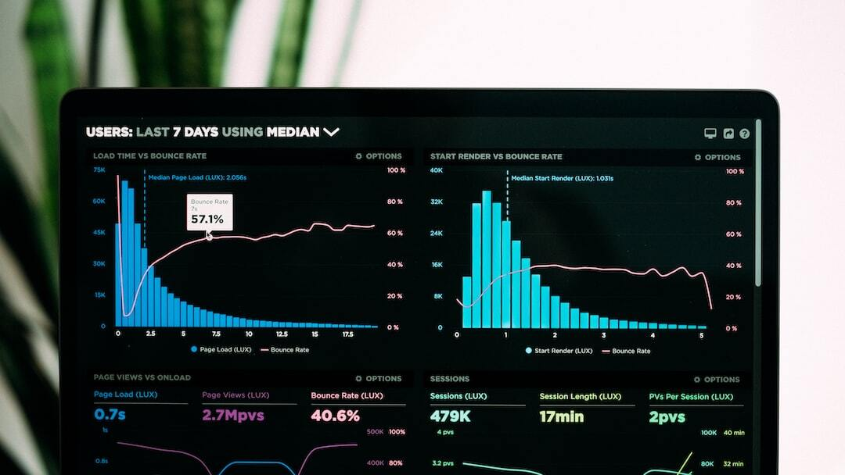
Exploratory Data Analysis
Visualizations: Utilized various plots such as line charts, histograms, and boxplots to understand data distribution and relationships.
I have analysed the quantity distribution by :
Time
Product Type
Sales Promotions
Weather
Trend Analysis: Linear Regression was used.
The sales declined from March 2021 to March 2022 by more than 50% , which makes sense as it was during Covid .
Outliers: Outliers were detected using the interquartile range method and removed.
Data was visualized again after the outliers were removed.

Slide 7
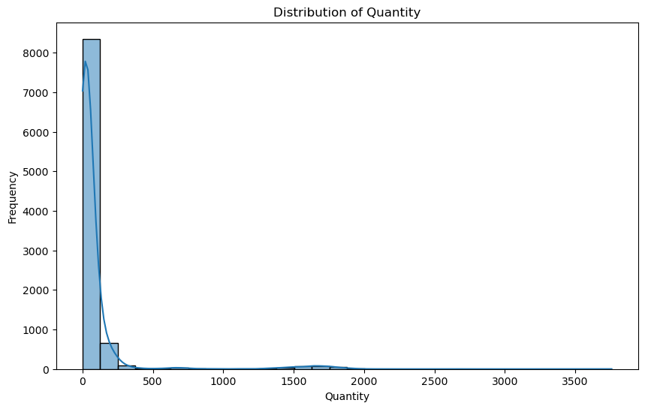
Distribution of Quantity
The distribution is highly right-skewed, indicating that the majority of the quantity values are clustered towards the lower end of the range.
There are noticeable outliers in the data, with quantities reaching up to 3500.
These outliers could have a significant impact on the analysis and should be investigated further.

Slide 8
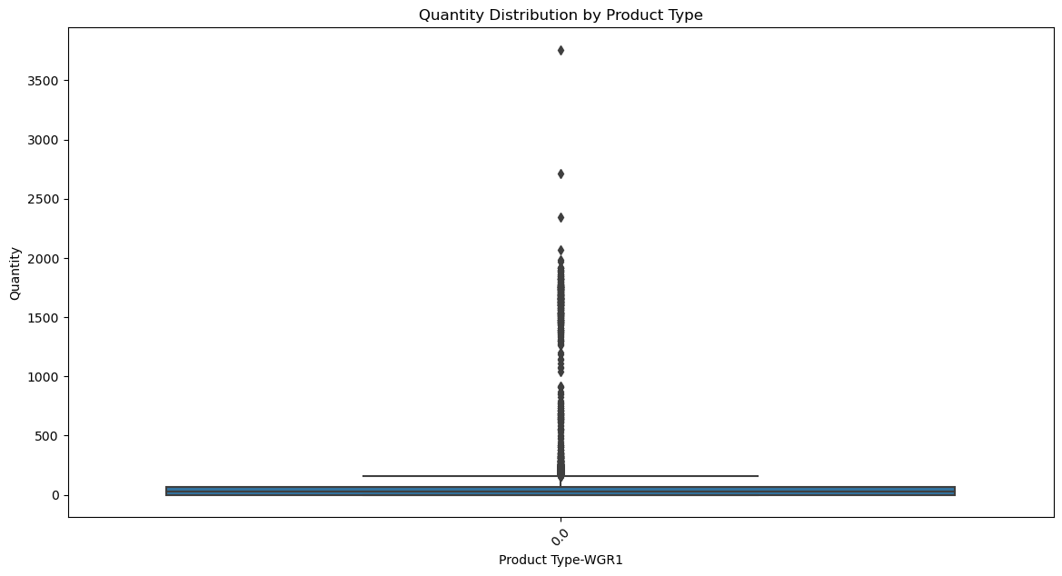
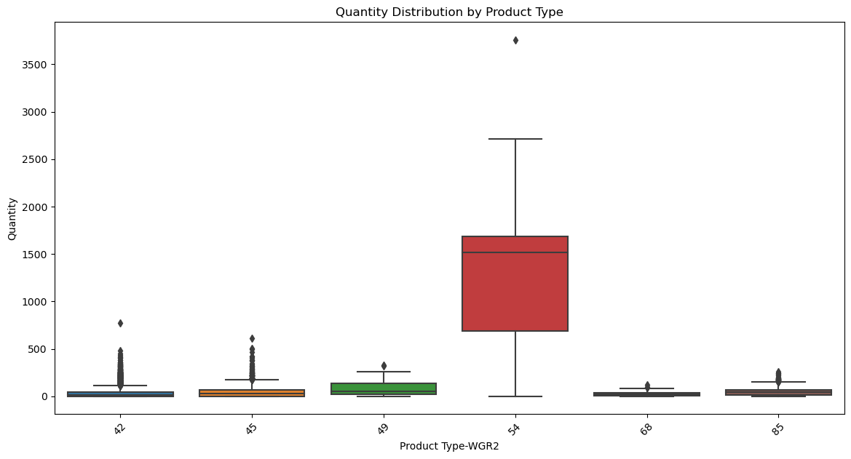
Quantity Distribution by Product Type
Interpretation for WGR1:
Highly Skewed Distribution:
The data distribution is highly skewed to the right, as evidenced by the long tail of outliers. This means that while most of the sales quantities for WGR1 are low, there are a few instances where the quantities are extremely high.
Potential Data Anomalies:
The presence of many high outliers suggests potential data anomalies or special events. These could be large bulk orders or specific periods where sales were exceptionally high.
Concentration of Low Values:
The narrow IQR and the short upper whisker show that the majority of the quantity values are concentrated around low numbers, which might indicate typical day-to-day sales quantities.
Interpretation for WGR2:
54 Stands Out:
Higher Sales Quantity: 54 has a significantly higher median and range of typical sales quantities compared to other product types.
Greater Variability: The larger IQR for 54 indicates more variability in the sales quantities, suggesting a broader range of typical sales volumes.
Consistent Low Quantities for Other Products:
The other product types show consistent low median values and tight IQRs, indicating that their sales quantities are consistently low and less variable.
Significant Outliers:
The presence of significant outliers for 54 and other product types suggests occasional large orders or sales events that deviate substantially from typical sales volumes.

Slide 9
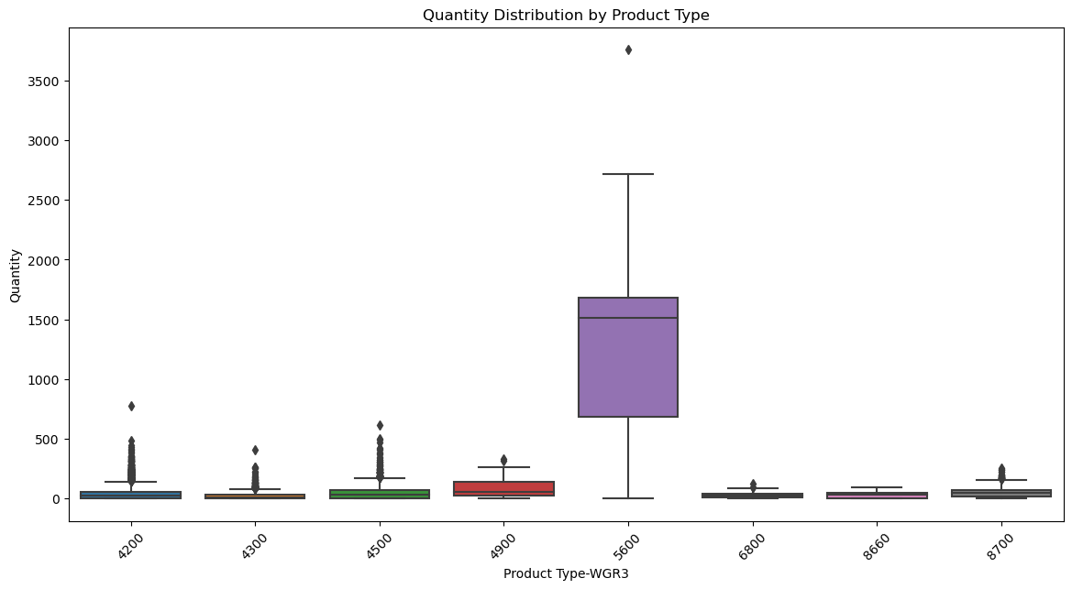
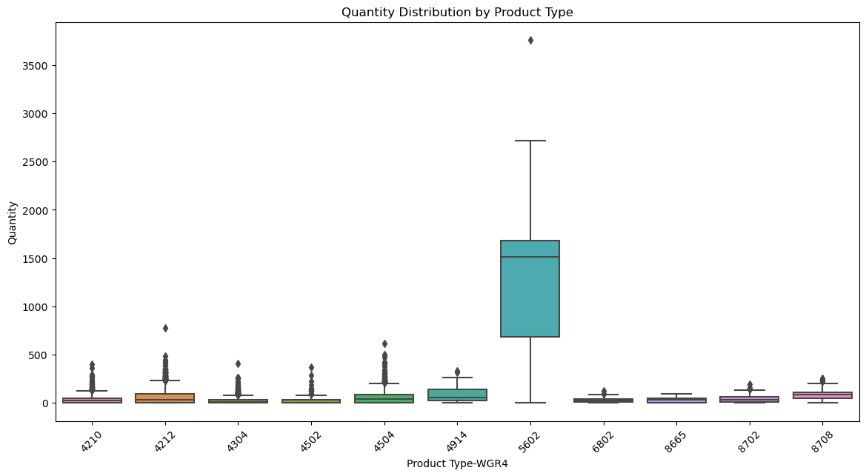
Quantity Distribution by Product Type
Interpretation for WGR3:
5600 Stands Out:
Higher Sales Quantity: 5600 has a significantly higher median and range of typical sales quantities compared to other product types.
Greater Variability: The larger IQR for 5600 indicates more variability in the sales quantities, suggesting a broader range of typical sales volumes.
Consistent Low Quantities for Other Products:
The other product types show consistent low median values and tight IQRs, indicating that their sales quantities are consistently low and less variable.
Significant Outliers:
The presence of significant outliers for 5600 and other product types suggests occasional large orders or sales events that deviate substantially from typical sales volumes.
Interpretation for WGR4:
5602 Stands Out:
Higher Sales Quantity: 5602 has a significantly higher median and range of typical sales quantities compared to other product types.
Greater Variability: The larger IQR for 5602 indicates more variability in the sales quantities, suggesting a broader range of typical sales volumes.
Consistent Low Quantities for Other Products:
The other product types show consistent low median values and tight IQRs, indicating that their sales quantities are consistently low and less variable.
Significant Outliers:
The presence of significant outliers for 5602 and other product types suggests occasional large orders or sales events that deviate substantially from typical sales volumes.

Slide 10
Outlier Analysis
Boxplots shows the presence of Outliers
Investigate the high outliers to understand the reasons behind the spikes in quantity. This could involve looking at the dates of these outliers, any promotions or special events, or particular customers responsible for large orders.
Data doesn’t follow a normal distribution, hence InterQuartile method is used to detect Ouliers
The DataFrame is filtered to create a new DataFrame that excludes rows with outlier values

Slide 11
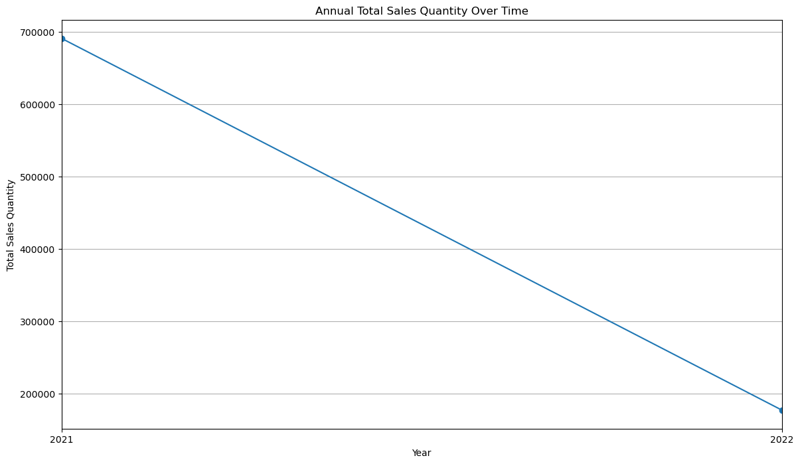
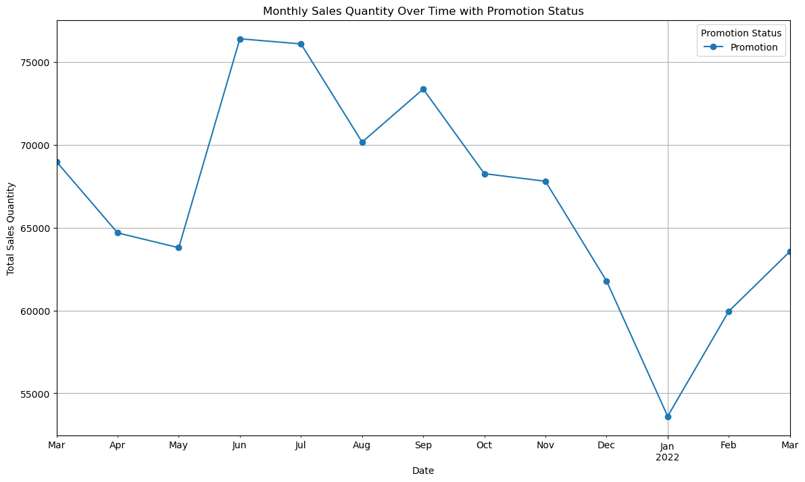
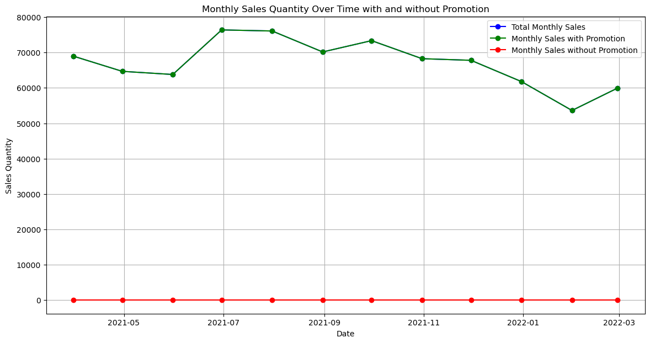
Impact of Promotions on Sales
Visualize monthly sales quantities over time, distinguishing between periods with and without promotions.
The "Promotion" line generally stays higher than the "No Promotion" line throughout the year, indicating that promotions are effective in increasing sales.
Both lines show a spike in sales during July and August, suggesting a seasonal trend likely due to holiday shopping.
There is a noticeable drop in sales from December to January, which could be due to a specific market event or a correction after high sales in the preceding months.
There seems to be a correlation between the spikes in the total sales quantity around June and the periods with promotions. If these spikes coincide with the promotions, it would suggest that promotions might be associated with increased sales quantity.

Slide 12
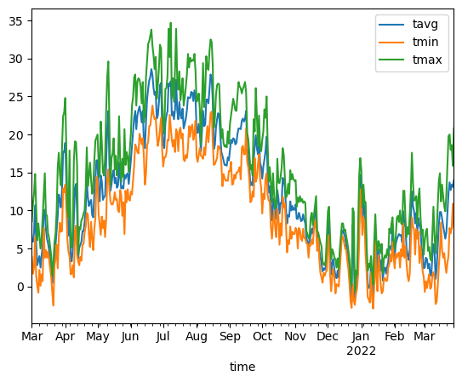
Temperature effect on Sales
Used the meteostat library for Vienna to analyse the temperature effect on Sales Quantity.
Visualize the sales data over the same period to identify any trends or seasonal patterns and correlation.
It is seen from the plots that Sales peaked during the summer months and dropped during winter.

Slide 13
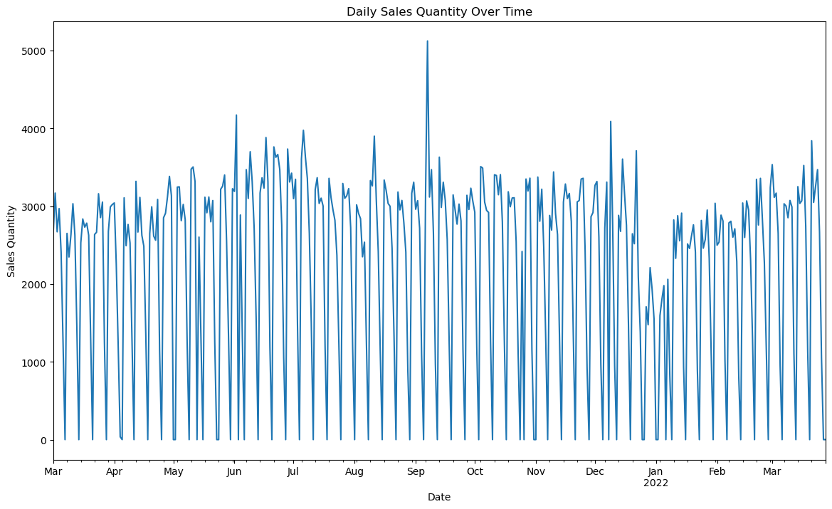
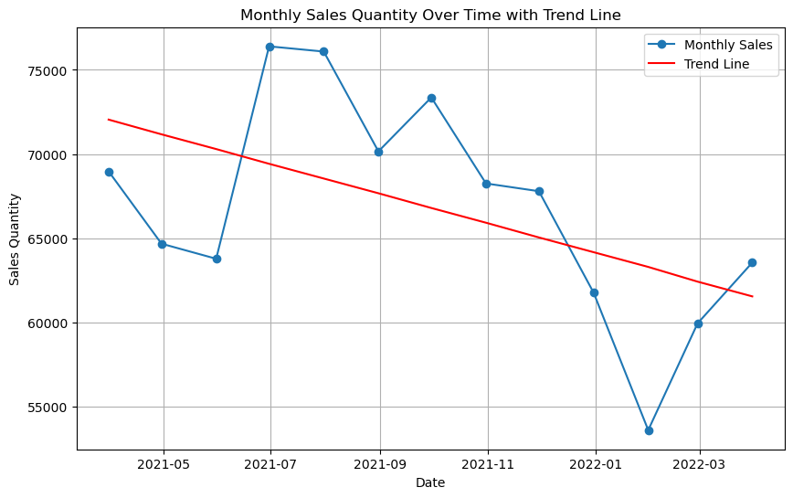
Checking for Stationarity, Seasonality and Trends
Stationarity:
Augmented Dickey-Fuller (ADF) test
Data was found to be stationary
Seasonality:
Seasonal decomposition of time series
Seasonal decomposition could not be performed as we had only 13 data points
Trend Analysis:
Fitting a linear regression model to check for trend.
A negative slope indicates a downward trend.

Slide 14
Data Prepration
Splitting the Data:
For time series analysis, the data should be split into training and testing sets based on time, not randomly.
Scaling the Data:
ARIMA: Scaling is not typically necessary for ARIMA models.
LSTM: Scaling is crucial for LSTM models to ensure that the neural network training is stable and effective. I have used Min-Max scaler.

Slide 15

Model Training
Since the data is stationary,I will use ARIMA and LSTM to train the models.
LSTM:
Normalize the data.
Convert the data into sequences.
Train the LSTM model on these sequences.
ARIMA:
Use raw time series data.
Train the ARIMA model directly on the raw data.
Prediction:

Slide 16
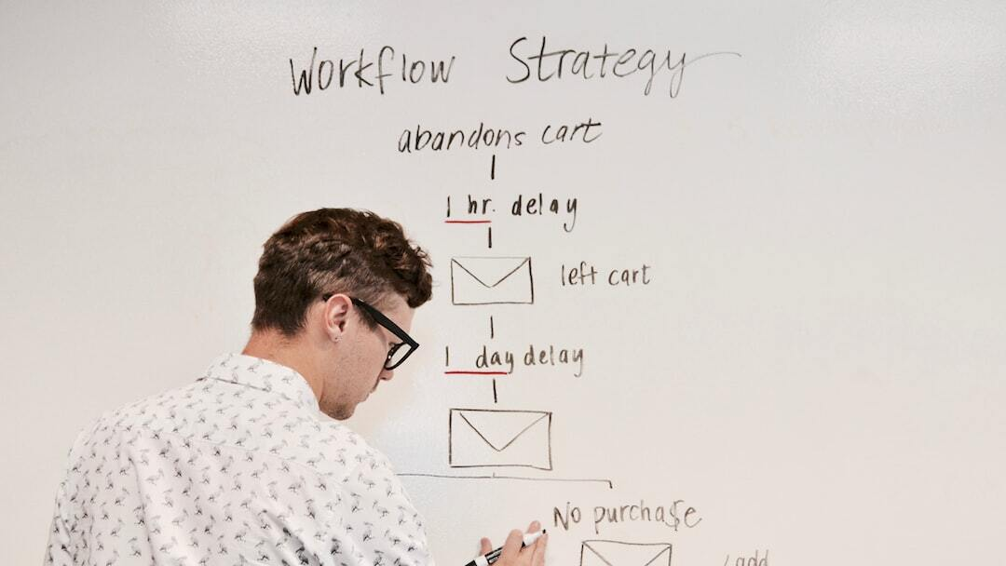
Model Evaluation
RMSE, MAE, MAPE: Compare these metrics for both ARIMA and LSTM models.
Lower values indicate better performance.
Visual Inspection: Plot the actual vs. predicted values for both models to visually inspect how well each model is capturing the trends and patterns.

Slide 17
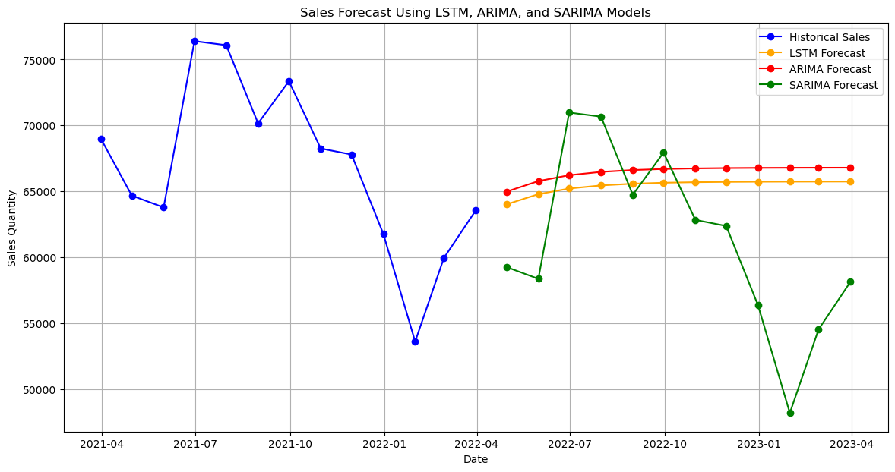
Forecast
The ARIMA model performed better at predicting the sales quantity of the item compared to LSTM as the data is linear and has a strong negative trend.
The forecast may only be accurate for a short period of time. This is because future sales can be influenced by many factors that are difficult to predict, such as changes in the economy, consumer preferences, and competitor activity.

Slide 18

Next Steps
There are several ways to improve the performance of your ARIMA and LSTM models for sales forecasting. Here are some steps you can follow:
Improve data quality: Ensure your sales data is clean and free of errors. Address missing values and outliers.
Feature engineering: Consider including additional relevant features that might influence sales, like holidays, promotions, or economic indicators.
Hyperparameter tuning: Experiment with different hyperparameter values for each model. This can involve adjusting the number of lags in ARIMA or the network architecture in LSTM.
Techniques like GridSearchCV or RandomizedSearchCV can automate this process https://neptune.ai/blog/improving-ml-model-performance.
Early stopping: Implement early stopping to prevent overfitting. This technique stops training the model once the validation error starts to increase, allowing it to focus on generalizability.
Ensemble methods: Explore combining multiple models (ARIMA, SARIMA, LSTM) using ensemble methods like averaging or stacking. This can often improve overall accuracy by leveraging the strengths of each model.

Slide 19
Thank you!

